Slide 1



GRADE 11 · ALGEBRA II · TOPIC 6
Lesson 6-5
Properties of
Logarithms
Journey of 6 stations, 60 minutes
Exponential and Logarithmic Functions
Mr Malek Thiab
FAITH, RIGHTEOUSNESS AND WISDOM
Notes:
Speaker notes: Welcome to Lesson 6-5: Properties of Logarithms.
Timing: 60 minutes (Diagnose 6, Targeted Instruction 18, Practice 12, Production 12, Mastery Gate 6, Smart Production 6). For a 40-minute class scale every station by two thirds.
The journey map on the next slide shows the six stations; in slideshow mode the Morph transition zooms the station circles into the breadcrumb at the top of every later slide.

Slide 2


Today's journey
Six stations. Each one zooms in as we arrive.
Targeted Instruction
18 min
Production
12 min
Smart Production
6 min
2
4
6
1
3
5
Diagnose
6 min
Practice
12 min
Mastery Gate
6 min
FAITH, RIGHTEOUSNESS AND WISDOM
Notes:
Speaker notes: This is the whole map. Walk it left to right: Diagnose (what we already know), Targeted Instruction (Products and quotients become sums and differences; Powers come to the front; The change of base formula; Logarithms and geometric sequences), Practice (Practice, Apply, Investigate), Production (Red Sea tourism growth), Mastery Gate (three questions to pass), Smart Production (create, then Time to Check).
In slideshow mode the Morph transition animates these circles shrinking into the breadcrumb on later slides; without Morph the slides fade.
Ask the class which station they think will be hardest.

Slide 3
What we are learning
OBJECTIVES
VOCABULARY
Apply properties of logarithms to rewrite logarithmic expressions and evaluate logarithms.
Use the change of base formula to rewrite and evaluate logarithmic expressions.
change of base formula
logarithmic properties
STANDARDS
HSA.SSE.A.2 Use the structure of an expression to identify ways to rewrite it.
HSF.BF.A.2 Write arithmetic and geometric sequences both recursively and with an explicit formula, use them to model situations, and translate between the two forms.
HSF.LE.A.4 For exponential models, express as a logarithm the solution to abᶜᵗ = d where a, c, and d are numbers and the base b is 2, 10, or e; evaluate the logarithm using technology.
ESSENTIAL QUESTION
How can the properties of logarithms, including the change of base formula, be applied to simplify and evaluate logarithmic expressions?
MATHEMATICAL PRACTICES MP.2 · MP.7
HSA.SSE.A.2 · HSF.BF.A.2 · HSF.LE.A.4
FAITH, RIGHTEOUSNESS AND WISDOM
Mr Malek Thiab · 3
Notes:
Speaker notes: Read the objectives aloud one at a time and have students say which one they feel least sure about.
Vocabulary used today: change of base formula, logarithmic properties.
Standards are listed on this slide.

Slide 4



1
2
3
4
5
6
STATION 1 · DIAGNOSE · 6 MIN
Start here: three quick checks
1
2
3
Done when
All three answers are written without a calculator, and you can say in one sentence what happens to the exponents when you multiply powers with the same base.
HSA.SSE.A.2 · HSF.BF.A.2 · HSF.LE.A.4
FAITH, RIGHTEOUSNESS AND WISDOM
Mr Malek Thiab · 4
Notes:
Speaker notes (Diagnose, 6 min, no calculator):
Answers. Q1: ask 'which power of 2 gives 32?' 2^5 = 32, so log_2 32 = 5. Q2: same base, add the exponents: 3 + 4 = 7, so 2^7 (which is 128). This is the seed of the product rule. Q3: 0.01 = 10^(-2), so log_10 0.01 = -2. Verbal misconceptions: Q2 students multiply the exponents (3 x 4 = 12) or add the bases; Q3 students answer 2 (dropping the negative sign) or 0.01; Q1 students answer 16 (dividing 32 by 2). Adaptive routing: if >30% miss Q1 or Q3, spend 3 minutes on converting between log form and exponential form (Lesson 6-3) before slide 5; if >30% miss Q2, recap the exponent laws on the board, then go to slide 5. If 90% of the class is correct, move quickly through slide 5 and spend the saved time on slide 7 and slide 8.

Slide 5

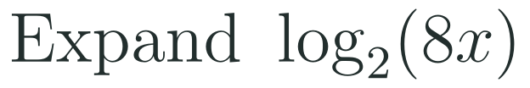
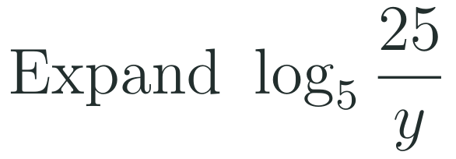


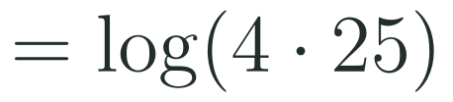




1
2
3
4
5
6
STATION 2 · TARGETED INSTRUCTION · 18 MIN
Products and quotients become sums and differences
EXAMPLE A
EXAMPLE B
EXAMPLE C
HSA.SSE.A.2 · HSF.BF.A.2 · HSF.LE.A.4
FAITH, RIGHTEOUSNESS AND WISDOM
Mr Malek Thiab · 5
Notes:
Speaker notes (Targeted Instruction, block 1 of 4):
Worked solutions. Why the rules work: let M = b^u and N = b^v. Then MN = b^(u+v), so log_b(MN) = u + v = log_b M + log_b N; the quotient is the same idea with subtraction (M/N = b^(u-v)). This is HSA.SSE.A.2: the structure of the expression tells us how to rewrite it. Assume x > 0 and y > 0 so every logarithm exists. Example A, expand log_2(8x): step 1 split the product: log_2 8 + log_2 x; step 2 log_2 8 = 3 because 2^3 = 8; result 3 + log_2 x. Example B, expand log_5(25/y): step 1 split the quotient: log_5 25 - log_5 y; step 2 log_5 25 = 2; result 2 - log_5 y. Example C, condense log 4 + log 25 (base 10): step 1 a sum of logs is the log of the product: log(4 x 25); step 2 log 100 = 2. Verbal misconceptions: (1) log(M + N) is NOT log M + log N; only a product or quotient INSIDE splits. (2) For quotients the order matters: log M - log N, never log N - log M. (3) The bases must match before the rules apply. (4) log_2 8 + log_2 x is not 'log_2 of 8 plus x'. Adaptive routing: if >30% get Example C wrong on whiteboards, repeat Example A with 4x and 5x; if students stumble on 25/y, redo with 9/y. Gate Q1 and Q3 route back to this slide and to slide 6.

Slide 6


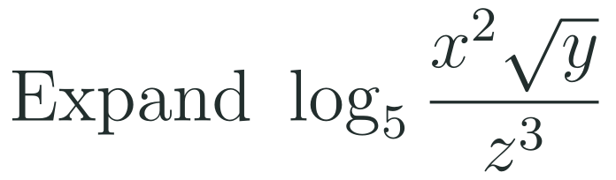

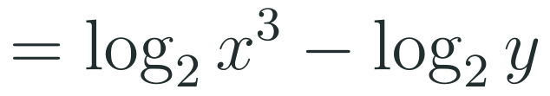
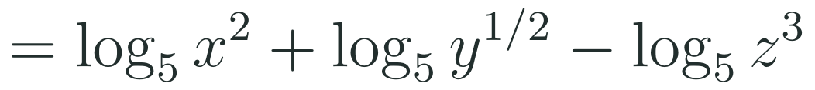
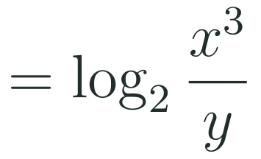
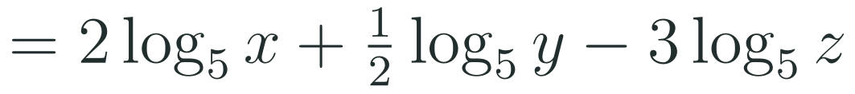
1
2
3
4
5
6
STATION 2 · TARGETED INSTRUCTION · 18 MIN
Powers come to the front
EXAMPLE A
EXAMPLE B
HSA.SSE.A.2 · HSF.BF.A.2 · HSF.LE.A.4
FAITH, RIGHTEOUSNESS AND WISDOM
Mr Malek Thiab · 6
Notes:
Speaker notes (Targeted Instruction, block 2 of 4):
Worked solutions. Why: let M = b^u. Then M^p = b^(up), so log_b(M^p) = up = p log_b M. A square root is the power one half, so log_b(sqrt(M)) = (1/2) log_b M. Example A, expand log_5( x^2 sqrt(y) / z^3 ): step 1 split the product and the quotient: log_5 x^2 + log_5 y^(1/2) - log_5 z^3; step 2 bring each exponent to the front: 2 log_5 x + (1/2) log_5 y - 3 log_5 z. Example B, condense 3 log_2 x - log_2 y: step 1 move the coefficient up as a power of x only: log_2 x^3 - log_2 y; step 2 combine into a quotient: log_2( x^3 / y ). Verbal misconceptions: (1) log(x^2) = 2 log x, but (log x)^2 is a different thing; (2) the coefficient 3 becomes a power of x only, not of y; (3) a square root is the power one half, not 2; (4) log x^2 is not 2 log(2x). Adaptive routing: if students stumble on the square root, use the second rule banner and redo Example A with sqrt(y) alone; if >30% miss Example B, redo with 2 log_3 x + log_3 5 = log_3(5x^2). Gate Q1 and Q3 route to this slide.

Slide 7





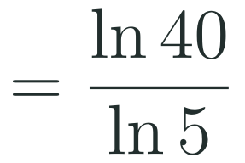
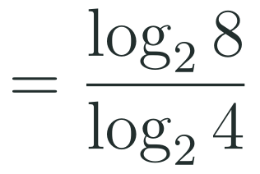
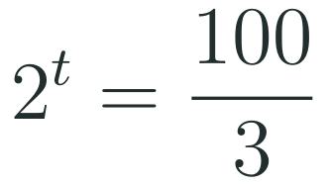

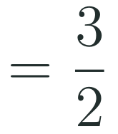
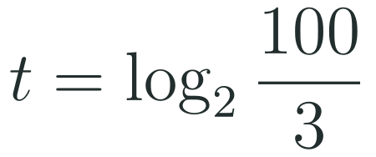
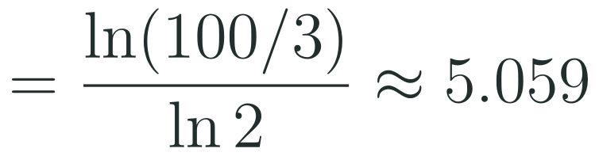
1
2
3
4
5
6
STATION 2 · TARGETED INSTRUCTION · 18 MIN
The change of base formula
EXAMPLE A
EXAMPLE B
EXAMPLE C
HSA.SSE.A.2 · HSF.BF.A.2 · HSF.LE.A.4
FAITH, RIGHTEOUSNESS AND WISDOM
Mr Malek Thiab · 7
Notes:
Speaker notes (Targeted Instruction, block 3 of 4):
Worked solutions. Why the formula works: let y = log_b x, so b^y = x. Take the log (any base a) of both sides: y log_a b = log_a x, so y = log_a x / log_a b. Calculators only have LOG (base 10) and LN (base e), so any other base is evaluated as a ratio. This is HSF.LE.A.4: express the solution as a logarithm, then evaluate it using technology. Example A, evaluate log_5 40: step 1 rewrite as ln 40 / ln 5; step 2 ln 40 = 3.68888 and ln 5 = 1.60944 (keep all the digits in the calculator); step 3 divide: about 2.292. Check: 5^2.292 is about 40. Example B, exactly log_4 8: choose base 2 because 8 = 2^3 and 4 = 2^2: step 1 log_2 8 / log_2 4; step 2 3 / 2. Check: 4^(3/2) = 8. Example C, solve 3 x 2^t = 100: step 1 divide by 3: 2^t = 100/3; step 2 write as a logarithm: t = log_2(100/3); step 3 change of base: ln(33.33)/ln 2 = 3.5066 / 0.6931, about 5.059. Check: 3 x 2^5.059 is about 100. Verbal misconceptions: (1) the formula is a RATIO of two logs, not log x minus log b; (2) argument on top, base on the bottom, never the reverse; (3) do not round ln 40 and ln 5 before dividing; (4) use LOG on top and bottom, or LN on top and bottom, never one of each. Adaptive routing: if >30% put the base on top in Example A, say 'the number goes on top, the base goes underneath' and redo with log_3 20; students who finish early try log_8 32 = 5/3. Gate Q2 routes to this slide.

Slide 8


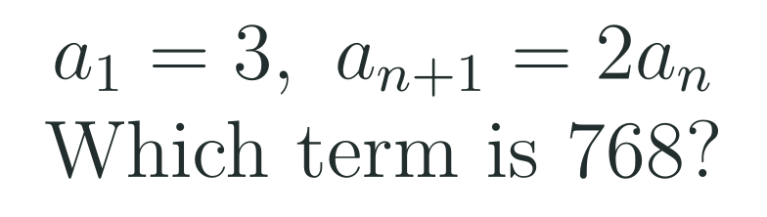
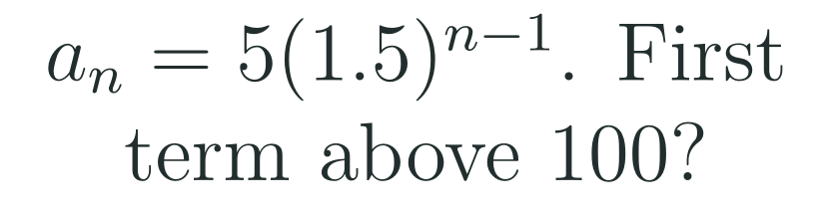



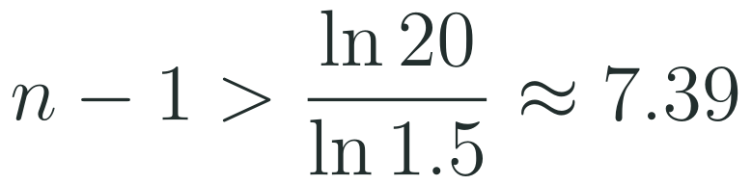

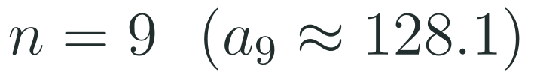
1
2
3
4
5
6
STATION 2 · TARGETED INSTRUCTION · 18 MIN
Logarithms and geometric sequences
EXAMPLE A
EXAMPLE B
HSA.SSE.A.2 · HSF.BF.A.2 · HSF.LE.A.4
FAITH, RIGHTEOUSNESS AND WISDOM
Mr Malek Thiab · 8
Notes:
Speaker notes (Targeted Instruction, block 4 of 4):
Worked solutions. This block covers HSF.BF.A.2: write a geometric sequence recursively and with an explicit formula, translate between the two forms, and use it to model a situation; logarithms are the tool that finds WHICH term. Example A: a_1 = 3 and a_(n+1) = 2 a_n is the recursive form; the explicit form is a_n = 3 x 2^(n-1). Set 3 x 2^(n-1) = 768; divide by 3: 2^(n-1) = 256; since 2^8 = 256, n - 1 = log_2 256 = 8, so n = 9. Check: 3 x 2^8 = 768. Example B: a_n = 5 x 1.5^(n-1) > 100; divide by 5: 1.5^(n-1) > 20; take the logarithm: n - 1 > ln 20 / ln 1.5 = 2.9957 / 0.4055 = 7.39; n is a whole number, so n - 1 = 8 and n = 9. Check: a_8 = 5 x 1.5^7 = 85.4 (below 100) and a_9 = 5 x 1.5^8 = 128.1 (above 100). Verbal misconceptions: (1) the exponent is n - 1, not n; (2) stop at 7.39 and say 'term 7.39': the term number must be a whole number, so round UP when the question says 'first term above'; (3) dividing 100 by 5 gives 20, not 95. Adaptive routing: if >30% write the exponent as n, return to the explicit formula with a_1 = 3 and list the first four terms; if >30% cannot round correctly, test the terms either side of the answer as in Example B. Production tasks 1 and 2 route here.

Slide 9
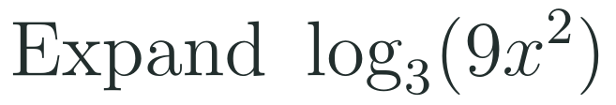
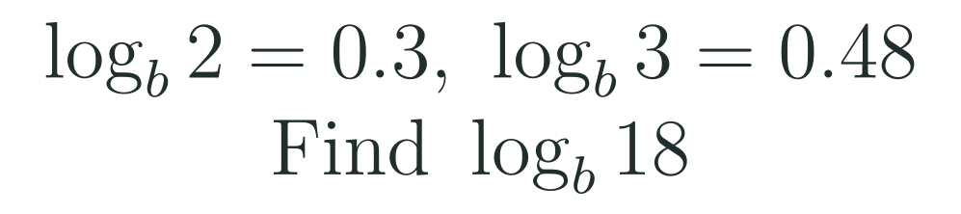
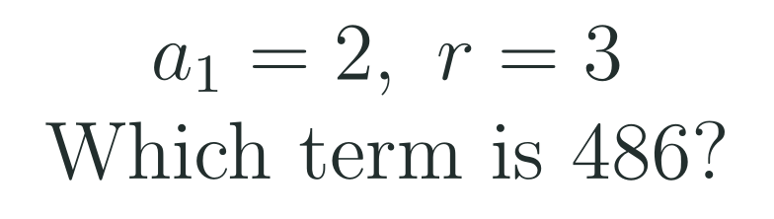
1
2
3
4
5
6
STATION 3 · PRACTICE · 12 MIN
Give it a go: Practice, Apply, Investigate
PRACTICE
APPLY
INVESTIGATE
Secure the method
Use it in context
Find out why
Done when: each property is named beside the step that uses it, and the decimal is rounded only at the last step.
Done when: 18 is split into factors before any property is used, and the term number is a whole number checked in the formula.
Done when: you give a counter-example with numbers for the first, and a reason that starts from writing M as a power of b for the second.
HSA.SSE.A.2 · HSF.BF.A.2 · HSF.LE.A.4
FAITH, RIGHTEOUSNESS AND WISDOM
Mr Malek Thiab · 9
Notes:
Speaker notes (Practice, 12 min; tierless differentiation: students choose the starting column and may move across):
Answers. Practice 1: log_3(9x^2) = log_3 9 + log_3 x^2 (product rule) = 2 + 2 log_3 x (power rule). Practice 2: log_6 10 = ln 10 / ln 6 = 2.302585 / 1.791759 = 1.285. Apply 1: 18 = 2 x 3^2, so log_b 18 = log_b 2 + 2 log_b 3 = 0.3 + 2(0.48) = 0.3 + 0.96 = 1.26 (these are model values). Apply 2: a_n = 2 x 3^(n-1) = 486; 3^(n-1) = 243; n - 1 = log_3 243 = 5; n = 6. Check: 2 x 3^5 = 486. Investigate 1: take M = N = 10: log(10 + 10) = log 20 = 1.301 but log 10 + log 10 = 2, so they are not equal; only a PRODUCT inside splits. Investigate 2: let M = b^u. Then M^p = b^(up), so log_b M^p = up, and u = log_b M, so it equals p log_b M. Verbal misconceptions: writing log_3 9x^2 = 2 + log_3 x (power applied to the 9 only), reading log_b 18 as 0.3 + 0.48 = 0.78 (adding instead of using 18 = 2 x 3 x 3), rounding ln 10 and ln 6 early. Adaptive routing: if >30% miss Practice 1, route to slide 5 Example A and slide 6; Practice 2 to slide 7 Example A; Apply 1 to slide 6; Apply 2 to slide 8. Students who finish Apply early move to Investigate.

Slide 10
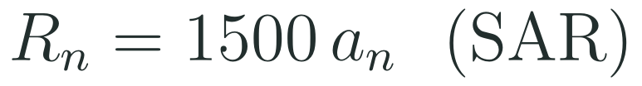
1
2
3
4
5
6
STATION 4 · PRODUCTION · 12 MIN
Production: Red Sea tourism growth
THE MODEL
DONE WHEN
A model for yearly visitors to a Red Sea destination on the Jeddah coast: 20 000 visitors in year 1, growing by 20 percent each year. Model values only, not a forecast. Each visitor spends a model 1 500 SAR. Planners want to know when the model first passes 100 000 visitors.
The terms are 20 000, 24 000, 28 800 and 34 560, and the recursive rule says multiply by 1.2.
The exact expression for the year number is written before any decimal.
The year is justified by testing the visitors in the year before and the year itself.
The revenue is about 154.8 million SAR, written with units.
Write the first four terms and the recursive rule, then check the fourth term with the formula.
Use a logarithm and the change of base formula to find the first year with more than 100 000 visitors.
Find the model revenue in that year, in millions of SAR.
Hint for solving: divide by 20 000 first, then ask which power of 1.2 gives 5, and use ln on the top and the bottom.
HSA.SSE.A.2 · HSF.BF.A.2 · HSF.LE.A.4
FAITH, RIGHTEOUSNESS AND WISDOM
Mr Malek Thiab · 10
Notes:
Speaker notes (Production, 12 min):
Model values only. Task 1: a_1 = 20 000; multiply by 1.2 each year: 24 000, 28 800, 34 560. Recursive rule: a_(n+1) = 1.2 a_n with a_1 = 20 000. Explicit check: a_4 = 20 000 x 1.2^3 = 20 000 x 1.728 = 34 560. Task 2: 20 000 x 1.2^(n-1) > 100 000; divide by 20 000: 1.2^(n-1) > 5; n - 1 > log_1.2 5 = ln 5 / ln 1.2 = 1.6094 / 0.1823 = 8.83; n is a whole number so n - 1 = 9 and n = 10. Check: a_9 = 20 000 x 1.2^8 = 85 996 (below 100 000) and a_10 = 20 000 x 1.2^9 = 103 196 (above). Task 3: R_10 = 1500 x 103 196 = 154 794 000 SAR, about 154.8 million SAR. Verbal misconceptions: using exponent n instead of n - 1; stopping at 8.83 and saying 'year 8.83' or rounding down to year 9; using 100 000 / 1.2 instead of 100 000 / 20 000. Adaptive routing: if >30% cannot start Task 1, go back to slide 8 Example A (recursive to explicit); if >30% miss Task 2, go to slide 7 (change of base) and then slide 8 Example B; Task 3 only needs the table of values. Early finishers: how many years does the model take to double? n - 1 = log_1.2 2 = ln 2 / ln 1.2 = 3.80 years.

Slide 11

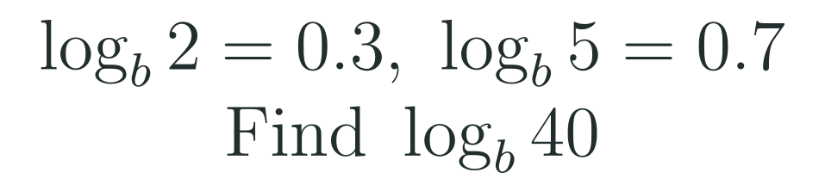
1
2
3
4
5
6
STATION 5 · MASTERY GATE · 6 MIN
Mastery Gate: three questions to pass
1
2
3
Pass mark
3 of 3 correct unlocks Station 6. Fewer than that: return to the slide for the question you missed, redo it, then re-take the gate.
HSA.SSE.A.2 · HSF.BF.A.2 · HSF.LE.A.4
FAITH, RIGHTEOUSNESS AND WISDOM
Mr Malek Thiab · 11
Notes:
Speaker notes (Mastery Gate, 6 min, no calculator):
Answers. Q1: 2 log_3 x = log_3 x^2 (power rule), then log_3 x^2 + log_3 5 = log_3(5x^2) (product rule). Q2: log_7 50 = ln 50 / ln 7 = 3.912023 / 1.945910 = 2.010. Q3: 40 = 2^3 x 5, so log_b 40 = 3 log_b 2 + log_b 5 = 3(0.3) + 0.7 = 0.9 + 0.7 = 1.6 (model values). Verbal misconceptions: Q1 writing log_3(5 + x^2) or log_3(2x) + log_3 5; Q2 swapping the ratio (ln 7 / ln 50 = 0.497) or rounding early; Q3 writing 0.3 x 3 as 3 + 0.3, or using 40 = 4 x 10 without values for log_b 10. Adaptive routing: Q1 missed, route to slide 5 and slide 6; Q2 missed, route to slide 7; Q3 missed, route to slide 6 Example A. If a student misses two or more, they join the teacher group for the Smart Production create step; students who get all three correct start the create step immediately.

Slide 12
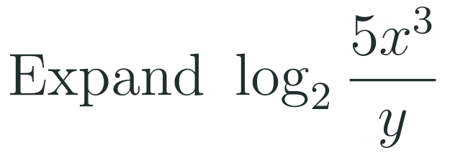
1
2
3
4
5
6
STATION 6 · SMART PRODUCTION · 6 MIN
Smart Production: make one, then check it
CREATE
TIME TO CHECK
Write one change of base question with a base that is not on the calculator, and one expand-or-condense question with three terms.
Write a full solution on the back, naming the property beside every step.
Swap with a partner and solve theirs.
Exit ticket: write your answer on a sticky note and place it on the door.
Done when: both questions have one correct answer, and your solution names a property or the change of base formula at every step.
Next lesson: 6-6 Exponential and Logarithmic Equations and Inequalities.
HSA.SSE.A.2 · HSF.BF.A.2 · HSF.LE.A.4
FAITH, RIGHTEOUSNESS AND WISDOM
Mr Malek Thiab · 12
Notes:
Speaker notes (Smart Production, 6 min):
Worked solutions. Exit 1: log_2(5x^3 / y) = log_2 5 + log_2 x^3 - log_2 y (product and quotient rules) = log_2 5 + 3 log_2 x - log_2 y (power rule). Exit 2: log_3 20 = ln 20 / ln 3 = 2.995732 / 1.098612 = 2.727. Verbal misconceptions: Exit 1 writing 5 log_2 x^3 or forgetting that only x is cubed; Exit 2 putting ln 3 on top. Adaptive routing: if >30% miss exit 1, start 6-6 with a ten-minute recap of slides 5 and 6; if >30% miss exit 2, open 6-6 with slide 7 Example A. Create step: check that every student question has a single answer; the partner solves it as a mastery check.

Slide 13
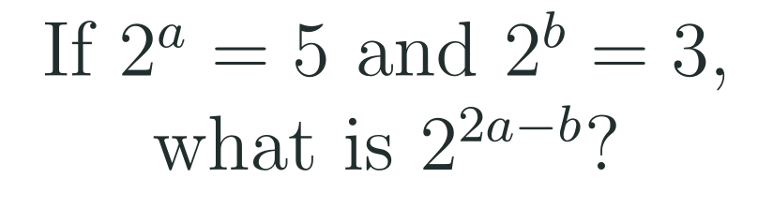



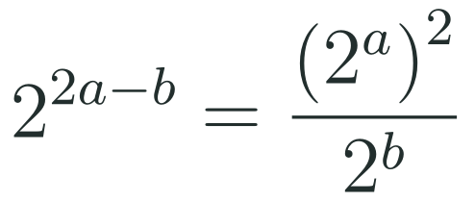
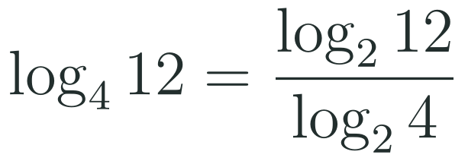
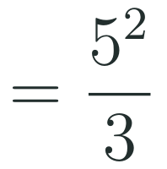

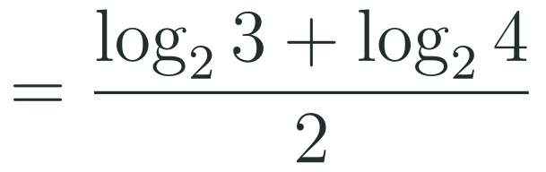
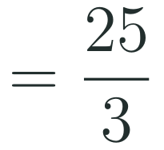

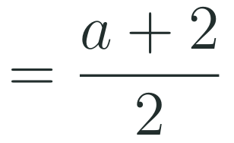
Exam connections
SAT
GAT
SAAT
STEPS
STEPS
STEPS
1
1
1
2
2
2
3
3
3
HSA.SSE.A.2 · HSF.BF.A.2 · HSF.LE.A.4
FAITH, RIGHTEOUSNESS AND WISDOM
Mr Malek Thiab · 13
Notes:
Speaker notes: each exam item is worked in numbered steps.
SAT (Advanced Math, equivalent expressions; global style, no calculator): 2^(2a - b) = (2^a)^2 / 2^b = 5^2 / 3 = 25/3. This is the exponent-law form of the product, quotient and power rules (2^a = 5 means a = log_2 5). Trap: writing 5^2 - 3 = 22 (subtracting instead of dividing), or (5/3)^2. Check: a = log_2 5 = 2.3219 and b = log_2 3 = 1.585, so 2a - b = 3.059 and 2^3.059 = 8.33 = 25/3. GAT/Qudurat quantitative comparison ('Which quantity is greater?': A is greater / B is greater / they are equal / not enough information): log_10 25 + log_10 4 = log_10(25 x 4) = log_10 100 = 2, so A = B and the answer is 'they are equal'. Trap: adding inside (log_10 29) or comparing the numbers 25 + 4 with 2. SAAT/Tahsili (multiple choice): log_4 12 = log_2 12 / log_2 4; log_2 12 = log_2 3 + log_2 4 = a + 2; log_2 4 = 2; so (a + 2)/2 = 1 + a/2. Trap: choosing a/2 (forgetting the + 2 from log_2 4) or a + 2 (forgetting to divide by log_2 4). Check: a = 1.585 gives 1.792 = log_4 12. Adaptive routing: if >30% miss the SAT item, return to slide 5 Example A and the exponent laws on slide 4; the GAT item, slide 5 Example C; the SAAT item, slide 7 Example B.

Slide 14
Journey complete
Targeted Instruction
Production
Smart Production
✓
✓
✓
✓
✓
✓
Diagnose
Practice
Mastery Gate
Products become sums, quotients become differences, powers come to the front, and the change of base formula turns any logarithm into a ratio you can evaluate.
FAITH, RIGHTEOUSNESS AND WISDOM
Notes:
Speaker notes: Every station is checked off. Recap in one sentence: Products become sums, quotients become differences, powers come to the front, and the change of base formula turns any logarithm into a ratio you can evaluate. Collect the Time to Check responses. Next lesson: 6-6 Exponential and Logarithmic Equations and Inequalities.

